Slide 1
Prototype of Integrating Accessibility Open Source Software using GCPedia
Team Name: | JETS-10 | Team: | Cameron Turner (Designer), Zaidoon Abd Al Hadi (Developer), Lu Frattaroli (Project Manager / User Lead) (Immigration, Refugees and Citizenship Canada)
Background: | Web Applications developed using programming languages such as JavaScript, PHP and Python present excellent opportunities to integrate Open Source Software (OSS) to add functionality to an application. Developers can design components to be instrumented at key points in a web application to integrate one or more OSS Application Programming Interfaces (API) to provide expertise in areas such as accessibility, business intelligence and machine learning. Implementing OSS software into an application is an agile, budget-friendly method of improving applications.
Project Details: | Our team worked on designing and implementing a prototype to add a speech recognition function to GCPedia to evaluate voice commands as a means of increasing accessibility in government web applications. We used the Open Source Software, SpeechKITT 0.3.0, available through github, Google’s Speech Web Service and a Logitech headset plugged into a workstation. To assist a user in accessing the GCPedia interface, we developed a speech component to act as the glue between the GCPedia software (MediaWiki), the SpeechKITT API and the Google Speech Web Service. We instrumented the main index.php page with a hook into our speech component developed in JavaScript. Within our custom developed code, we compare the user’s voice command with all the page functions’ HTML Attribute types (i.e., <a>) in order to determine if there is a match. If there is a match, then that page function is invoked. For the Search command, a slightly different approach was taken in order to populate the search criteria text box.
Prototype Results: | Within the timelines of a two day project, it’s difficult to accurately determine the effectiveness of integrating speech recognition in GCPedia. The results from simple, speech activated tasks such as page navigation were encouraging. More complex tasks, however, may require a sophisticated speech understanding algorithm to handle their corresponding voice commands.
Future Work: | In order to improve the prototype and more accurately evaluate the effectiveness of speech recognition, we would have to integrate the speech recognition functionality more extensively throughout the application. Also, Google’s Speech Web Service is quite accurate but if improved speech recognition accuracy was required, an OSS machine learning API could be used to learn speech patterns. Finally, a configuration file can be used as a light-weight alternative to a database to store more complex voice commands in a data dictionary. In either case, storing the voice command dictionary in a database or configuration file would allow for a more agile deployment as this dictionary may change at a faster pace than other code in the system.

Slide 2
Prototype of Integrating Accessibility Open Source Software using GCPedia
System Design

Slide 3
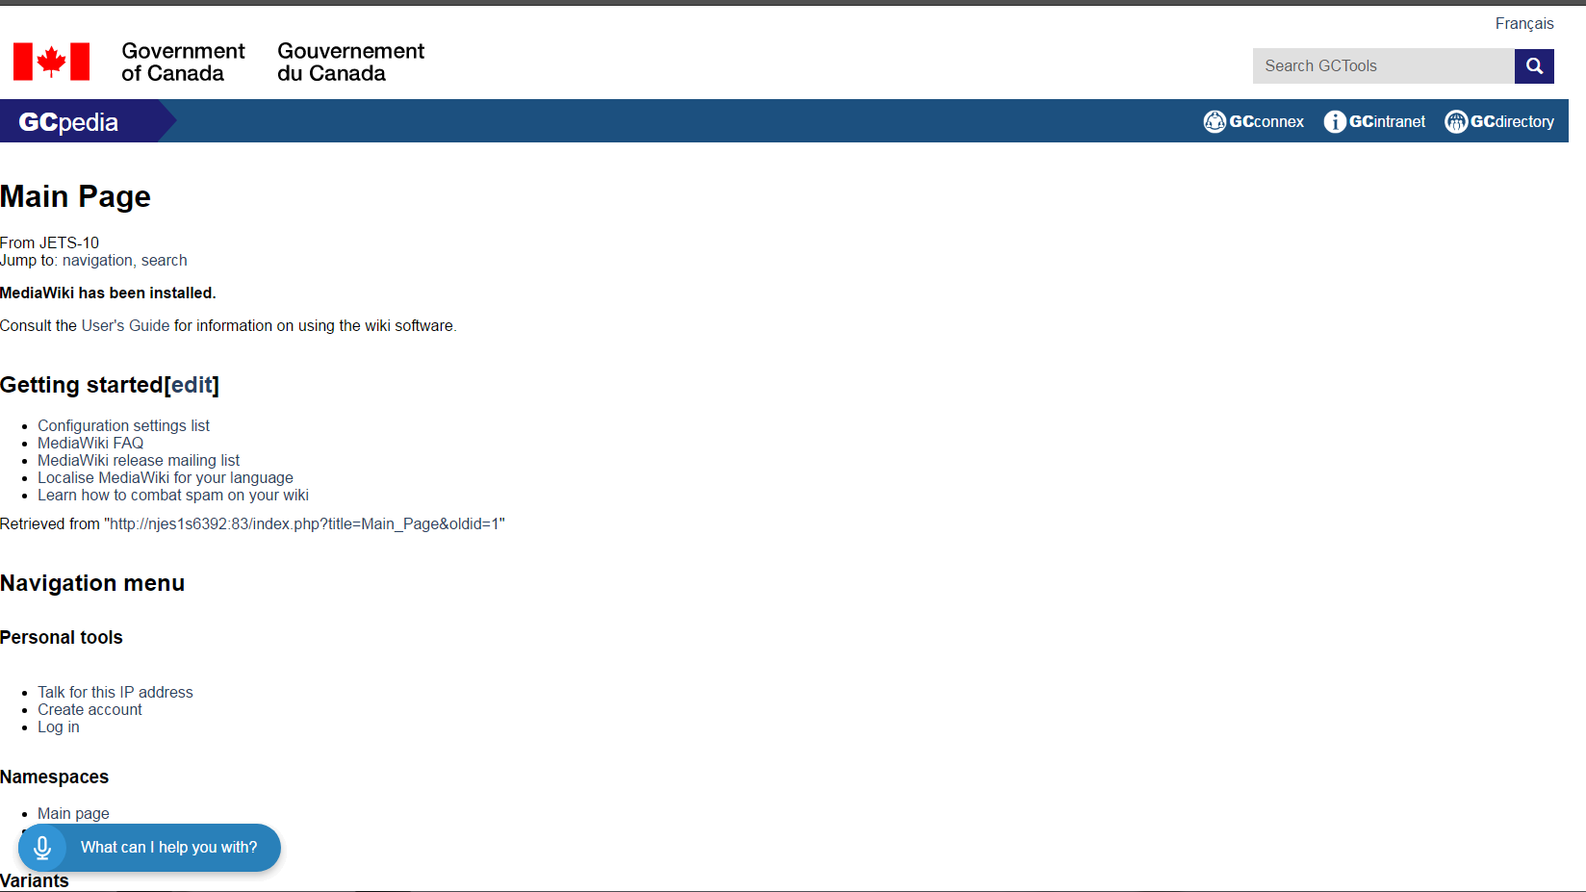
Prototype of Integrating Accessibility Open Source Software using GCPedia
Prototype Screenshot
The only visual is the SpeechKITT microphone image

